Slide 1

HTML5 Fundamentals
Welcome to this deep dive into HTML5! This presentation is designed for web developers and students eager to master the foundational language of the web. We'll explore the core concepts, new features, and best practices that make HTML5 the powerful and versatile tool it is today. Get ready to enhance your web development skills and build more semantic, interactive, and robust web applications.

Slide 2
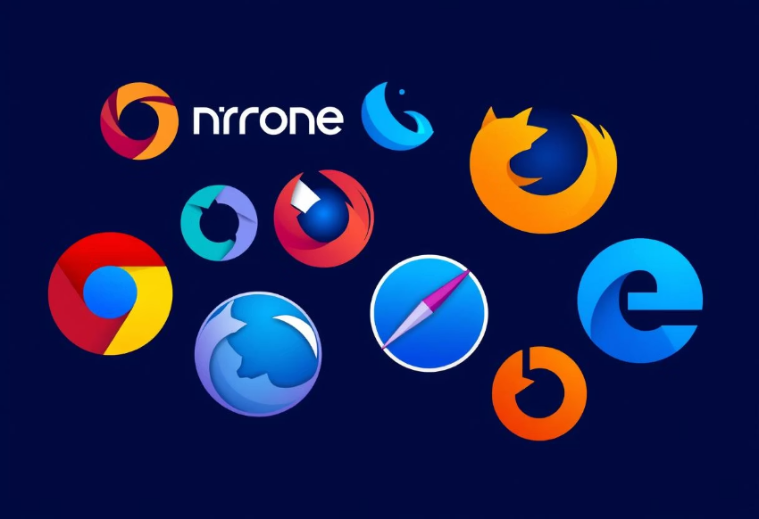
Introduction to HTML5
HTML5 is the latest evolution of the Hypertext Markup Language, bringing significant advancements over its predecessor, HTML4. It introduces new features that enable richer multimedia experiences, more semantic content structuring, and powerful APIs for enhanced interactivity.
Key Improvements
Browser Support
Native multimedia support (audio, video)
New semantic elements for better structure
Advanced APIs for web applications
Improved form controls and validation
Modern browsers offer extensive support for HTML5 features, ensuring broad compatibility for your web projects. While older browsers may have limitations, progressive enhancement strategies can help maintain functionality.

Slide 3
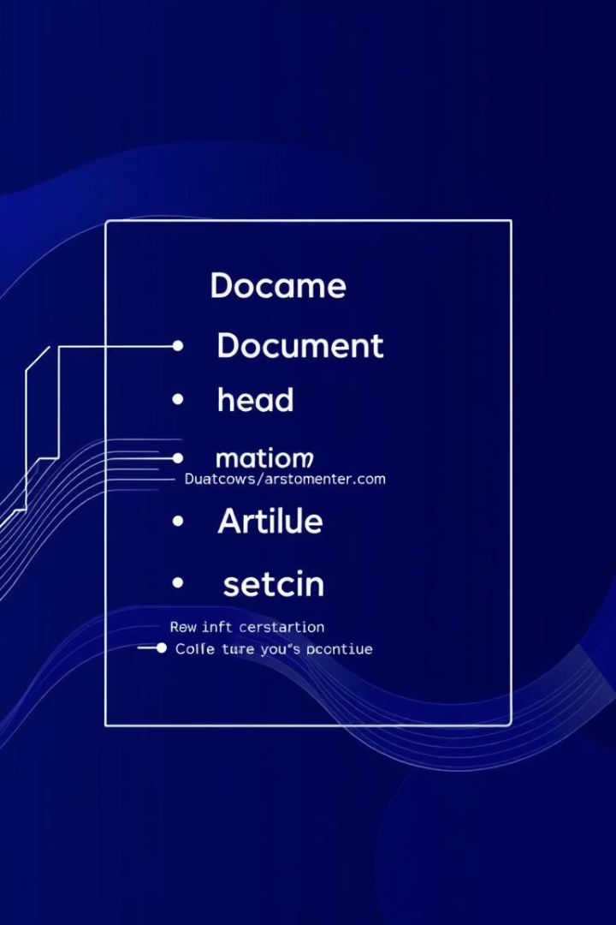
Basic Structure & Elements
Every HTML5 document begins with a simple, yet crucial, declaration to specify the document type. This informs the browser to render the page using HTML5 standards. The essential tags form the skeleton of every web page, while new structural elements provide a more meaningful organization for content.
<!DOCTYPE html>
<html>, <head>, <body>
The document type declaration for HTML5.
The root element, metadata container, and visible content container, respectively.
New Structural Elements
<header>: Introductory content or navigation links.
<nav>: Navigation links.
<article>: Self-contained content.
<section>: Generic standalone section.
<aside>: Content tangentially related to the main content.
<footer>: Footer for a document or section.

Slide 4
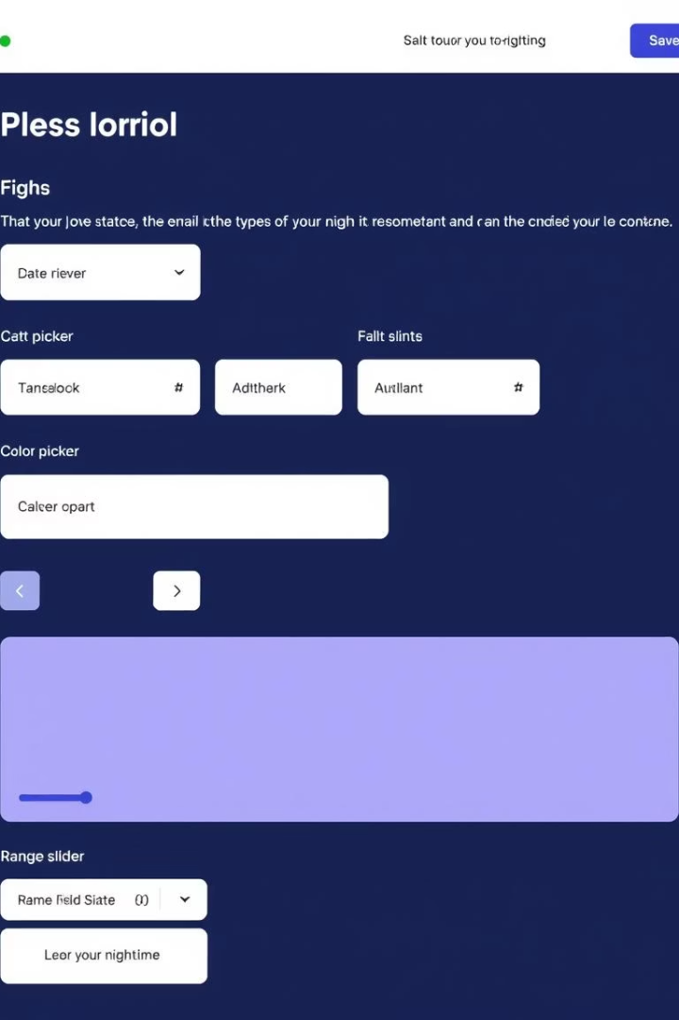




Forms & Input Types
HTML5 significantly enhances web forms with new input types and attributes, improving user experience and simplifying client-side validation. These additions allow developers to create more intuitive and robust forms without relying heavily on JavaScript for basic checks.
Email Input
Date Input
Range Input
<input type="email"> for email addresses.
<input type="date"> for calendar-based date selection.
<input type="range"> for numerical values within a specified range.
Color Input
<input type="color"> for a color picker interface.
Attributes like required, placeholder, and pattern further streamline form validation and usability, making it easier to create forms that guide users effectively.

Slide 5




Semantic HTML5
Semantic HTML refers to the use of HTML markup to reinforce the meaning of the information in web pages rather than just its appearance. It's crucial for accessibility, search engine optimization (SEO), and maintainability. By using semantic tags, you provide browsers and search engines with a clearer understanding of your content's structure and purpose.
SEO Benefits
Search engines better understand content context, improving ranking.
Accessibility
Screen readers can interpret content more effectively for users with disabilities.
Maintainability
Code becomes more readable and easier for developers to manage.

Slide 6




HTML5 APIs
HTML5 introduced a suite of powerful Application Programming Interfaces (APIs) that extend the capabilities of web browsers, allowing for more interactive and dynamic web applications. These APIs enable features previously only possible with plugins or complex server-side processing.
Geolocation API
Web Storage API
Allows web applications to access the user's geographical position, often used for location-based services.
Provides mechanisms for web applications to store data client-side, including localStorage (persistent data) and sessionStorage (data cleared when the session ends).
Canvas & WebGL
Drag & Drop API
Enable drawing graphics and animations on a web page using JavaScript, with WebGL extending this to 3D graphics rendered by the GPU.
Facilitates interactive user interfaces where elements can be dragged and dropped, common in file uploads and custom layouts.

Slide 7
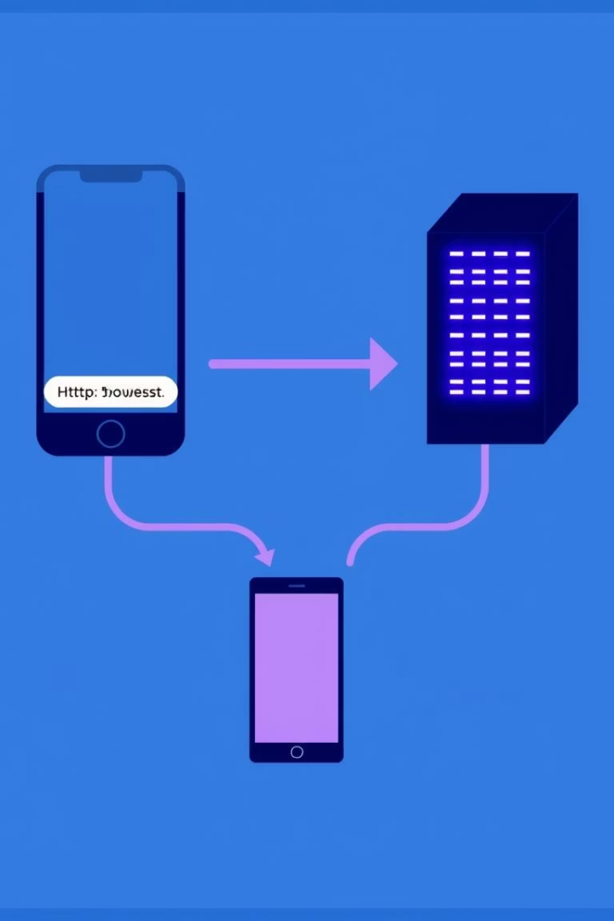




How Web Servers Work
Web servers are fundamental to delivering content across the internet. They store website files and serve them to clients (browsers) upon request, orchestrating the flow of information that makes the web work. Understanding their role is crucial for any web developer.
Client (Browser)
Initiates an HTTP request for a web page.
HTTP Request
Browser sends a request to the server.
Web Server
Receives the request and processes it (e.g., Apache, Nginx).
HTTP Response
Server sends back the requested HTML, CSS, JS, etc.
Web servers handle both static content (like HTML files and images) and dynamic content (generated on the fly by server-side scripts), ensuring a seamless user experience.

Slide 8


Development Process: Client vs. Server
Web development is broadly divided into client-side (frontend) and server-side (backend) development. Each plays a distinct role in creating a complete web application, requiring different sets of languages, frameworks, and technologies.
Client-Side (Frontend)
Server-Side (Backend)
Deals with everything the user sees and interacts with in their browser.
Manages data, handles requests, and communicates with databases, sending dynamic HTML to the client.
Languages: HTML5, CSS, JavaScript.
Languages: PHP, Python (Django/Flask), Node.js, Ruby.
Frameworks: React, Angular, Vue.js.
Databases: MySQL, PostgreSQL, MongoDB.
Execution: Code runs directly in the user's web browser.
Execution: Code runs on a server, not in the browser.

